Slide 1

Naïve Bayes and BERT
Hongyang Yang

Slide 2


Introduction & Approach
Hashtag Classification
Two Hashtags: #WarOnThanksgiving (Politics) & #awaeseason4 (Entertainment)
BERT for Main Usage and Naïve Bayes as Baseline

Slide 3
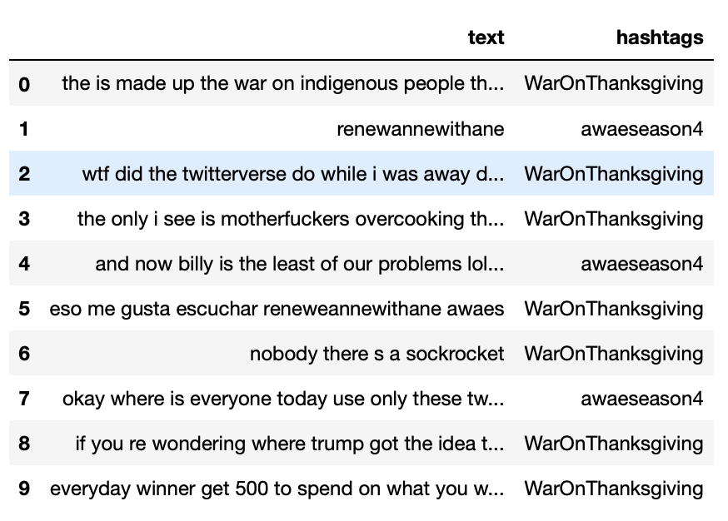
Dataset and Process
Extract hashtag with either word and full text from Twitter API
Collect more than 400, 000 pieces
Clean up characters, such as www…, https://..., RT, hashtag itself, or non-alphanumeric, with regular expression, and rows with missing values
Create balanced dataset with both hashtags of 10785 pieces
Split into train, dev, and test sets as 6:2:2

Slide 4
BERT Introduction
Paper: BERT: Pre-training of Deep Bidirectional Transformers for Language Understanding
BERT-BASE: 12 encoder layers, feedforward-networks with 768 hidden units, and 12 attention heads

Slide 5
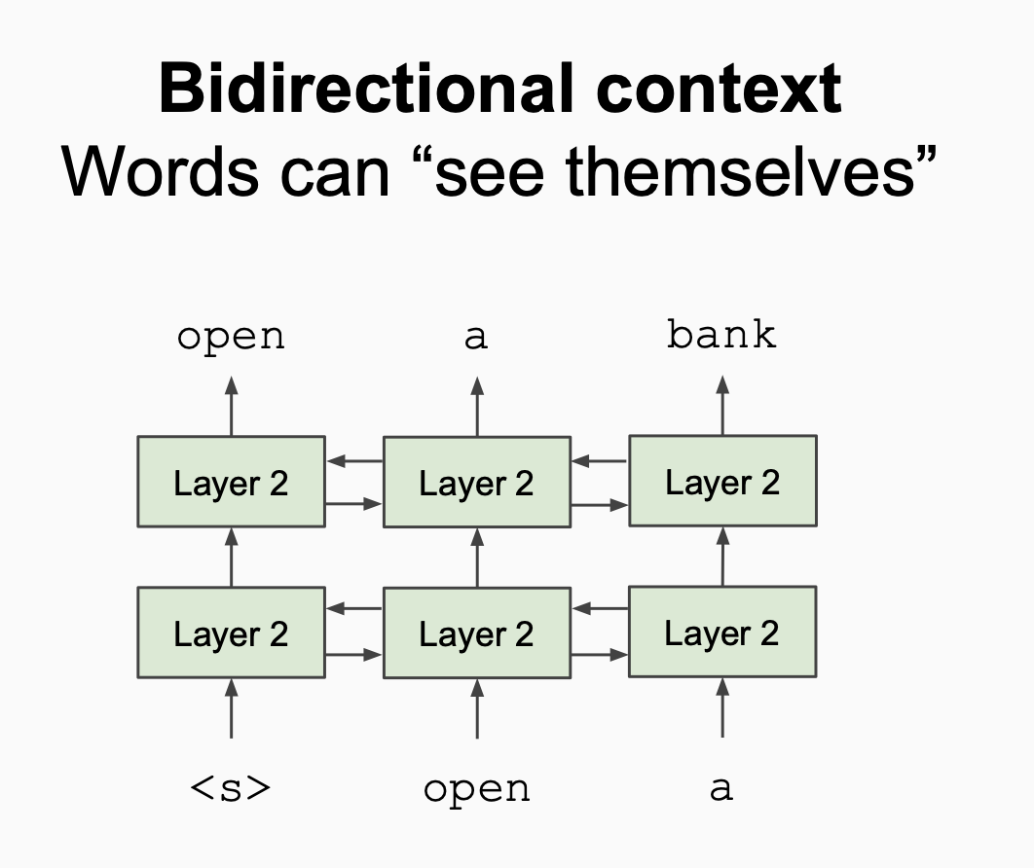
BERT Architecture
Bidirectional context
15% of the words in each sequence replaced by a [MASK] token before being fed into BERT
A [CLS] token is inserted at the beginning of the first sentence and a [SEP] token is inserted at the end of each sentence
Notes:
As opposed to directional models, which read the text input sequentially (left-to-right or right-to-left), the Transformer encoder reads the entire sequence of words at once. Therefore it is considered bidirectional, though it would be more accurate to say that it’s non-directional. This characteristic allows the model to learn the context of a word based on all of its surroundings (left and right of the word).
Before feeding word sequences into BERT, 15% of the words in each sequence are replaced with a [MASK] token. The model then attempts to predict the original value of the masked words, based on the context provided by the other, non-masked, words in the sequence. In technical terms, the prediction of the output words requires:
Adding a classification layer on top of the encoder output.
Multiplying the output vectors by the embedding matrix, transforming them into the vocabulary dimension.
Calculating the probability of each word in the vocabulary with softmax.
In the BERT training process, the model receives pairs of sentences as input and learns to predict if the second sentence in the pair is the subsequent sentence in the original document. During training, 50% of the inputs are a pair in which the second sentence is the subsequent sentence in the original document, while in the other 50% a random sentence from the corpus is chosen as the second sentence. The assumption is that the random sentence will be disconnected from the first sentence.

Slide 6
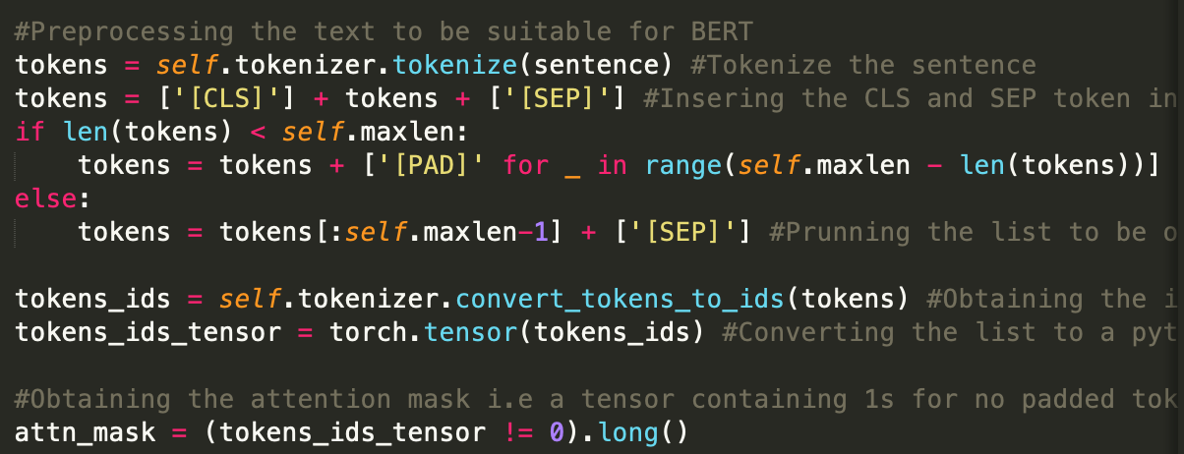
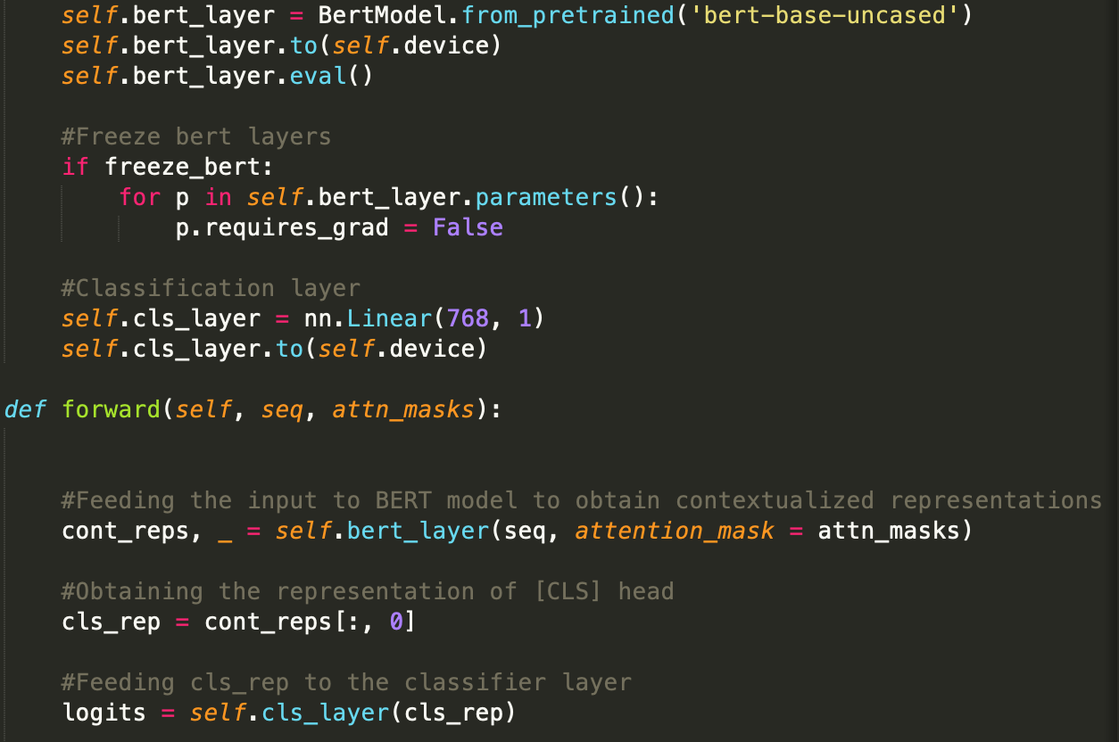
Model Construction
Tokenize the sequence
Add [CLS] and [SEP] tokens
Padding the input with [PAD]
Maintain a list of segment tokens
Obtaining indices of the tokens in BERT’s vocabulary

Slide 7
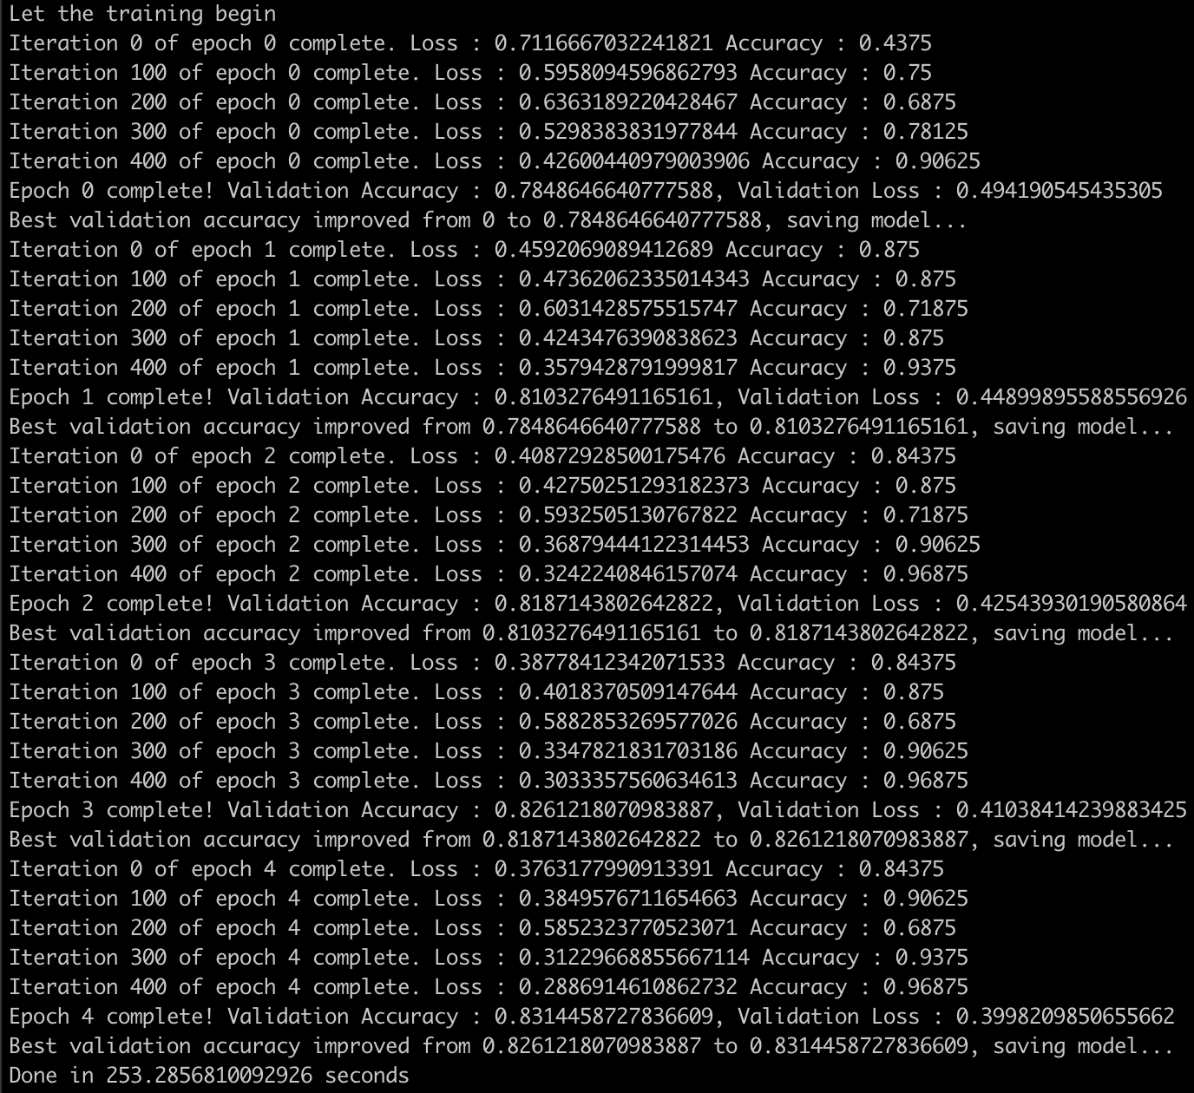
Training
Binary Cross-entropy Loss function: BCEWithLogitsLoss module
Optimizer: Stochastic Gradient Descent, ADAM
Learning Rate: 2e-5, 3e-5, 5e-5, 1e-4, 5e-4, 1e-3, 5e-3, 1e-2
Max_epoch: 5

Slide 8
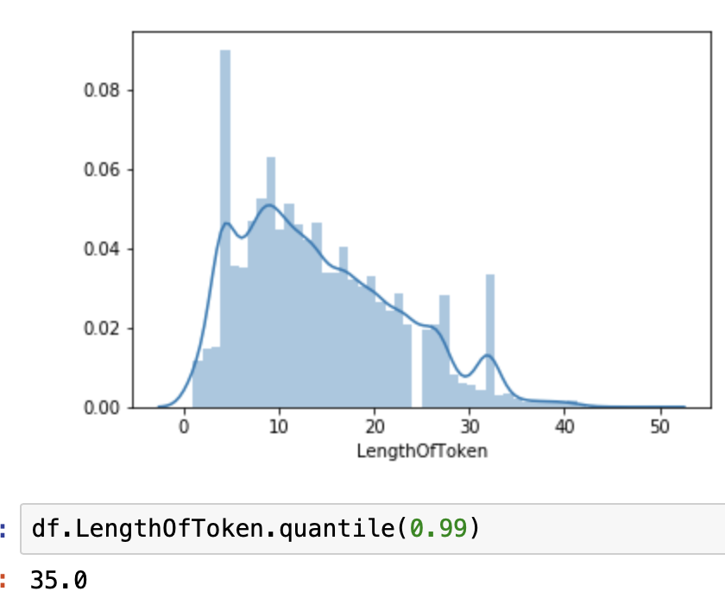
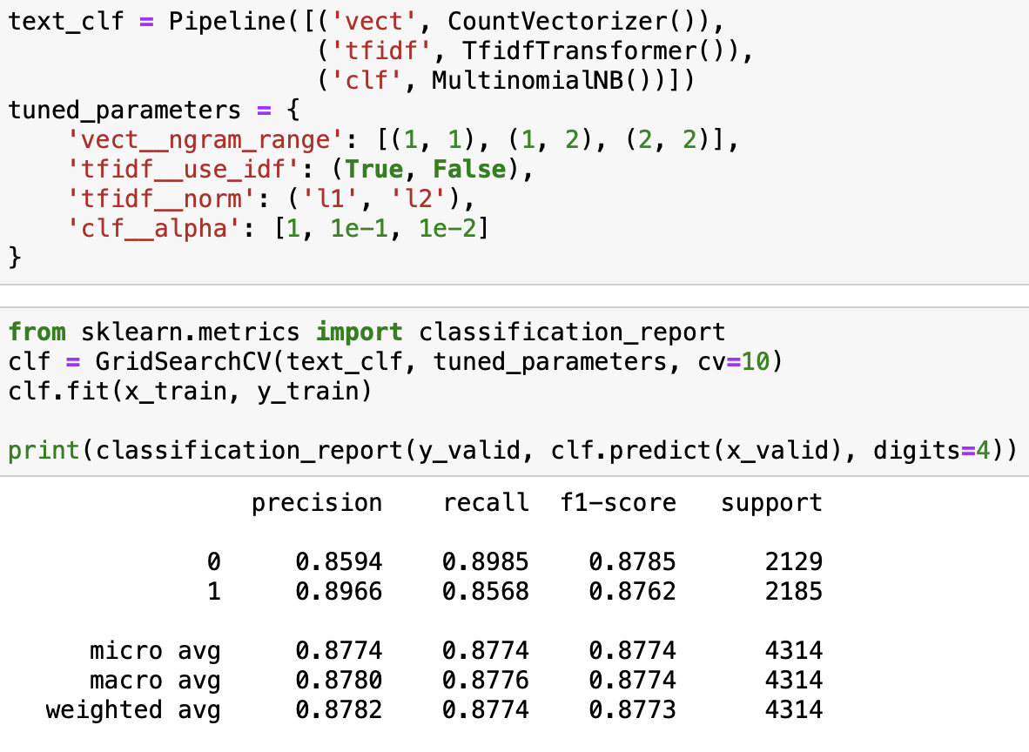

Comparison
Fine-Tuning BERT with Fast AI
Baseline: Naïve Bayes 0.877
Test Accuracy from BERT with learning rate 1e-2 and max_len 35: 0.854

Slide 9
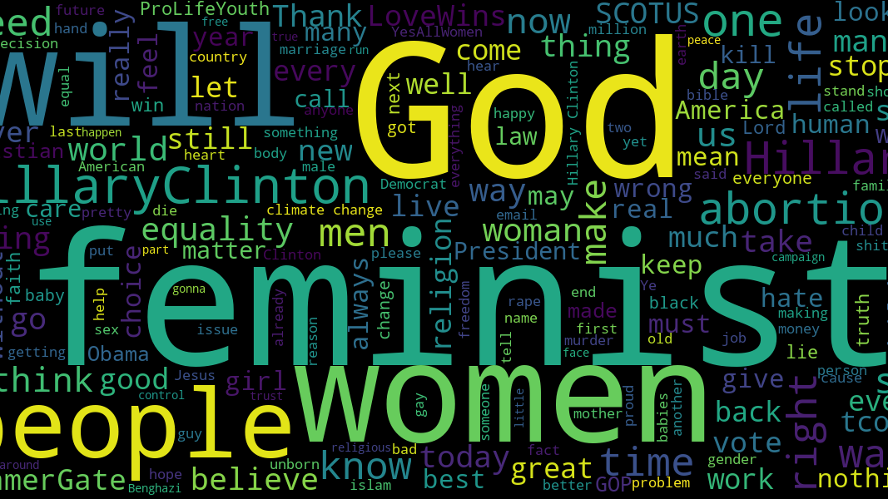
Conclusion and Improvement
Slightly over 10,000 tweets for each hashtag might be not enough for training
Binary Sentiment Analysis may be easier for Naïve Bayes
Tuning Parameter in the field of learning rate and modify the original dataset to be more precise
Find more baselines for controlled experiment

Slide 10


